Slide 1
Chapter 4: Threads (7th Edition) NARZU TARANNUM(NAT) LECTURER DEPT. OF CSE, BRAC UNIVERSITY

Slide 2
Chapter 4: Threads
Overview
Multicore Programming
Multithreading Models
Thread Libraries
Threading Issues
Operating System Examples

Slide 3
Motivation
Most modern applications are multithreaded
Threads run within application
Multiple tasks with the application can be implemented by separate threads
Update display
Fetch data
Spell checking
Answer a network request
Process creation is heavy-weight while thread creation is light-weight
Can simplify code, increase efficiency
Kernels are generally multithreaded

Slide 4
Benefits
Responsiveness – may allow continued execution if part of process is blocked, especially important for user interfaces
Resource Sharing – threads share resources of process, easier than shared memory or message passing
Economy – cheaper than process creation, thread switching lower overhead than context switching
Scalability – process can take advantage of multiprocessor architectures

Slide 5
Multicore Programming
Multicore or multiprocessor systems putting pressure on programmers, challenges include:
Dividing activities
Balance
Data splitting
Data dependency
Testing and debugging
Parallelism implies a system can perform more than one task simultaneously
Concurrency supports more than one task making progress
Single processor / core, scheduler providing concurrency

Slide 6
Multicore Programming (Cont.)
Types of parallelism
Data parallelism – distributes subsets of the same data across multiple cores, same operation on each
Task parallelism – distributing threads across cores, each thread performing unique operation
As # of threads grows, so does architectural support for threading
CPUs have cores as well as hardware threads
Consider Oracle SPARC T4 with 8 cores, and 8 hardware threads per core

Slide 7
Concurrency vs. Parallelism
Concurrent execution on single-core system:
Parallelism on a multi-core system:

Slide 8
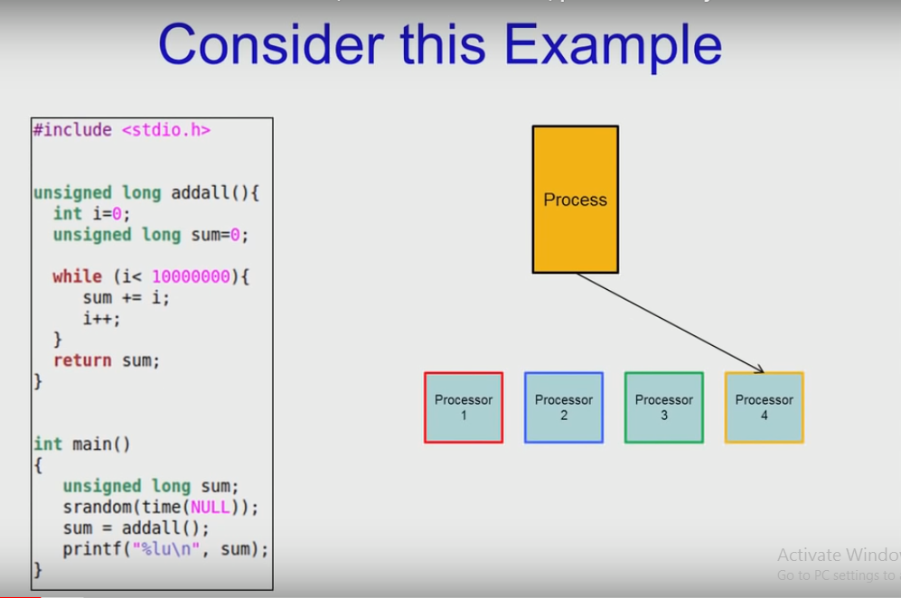

Slide 9
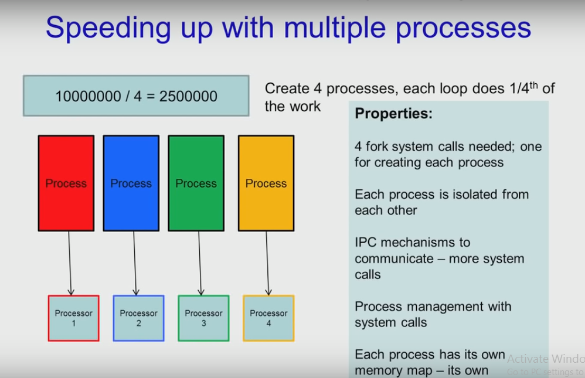

Slide 10
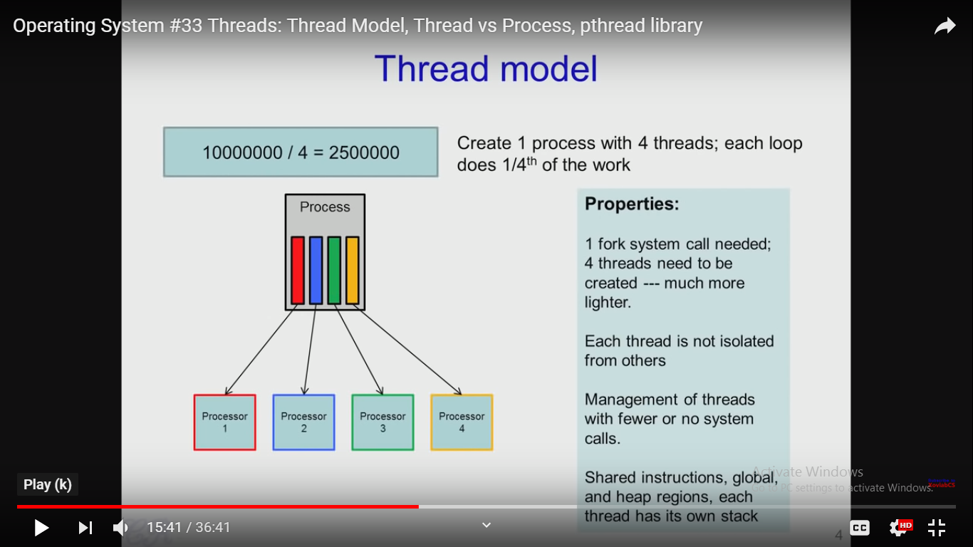

Slide 11
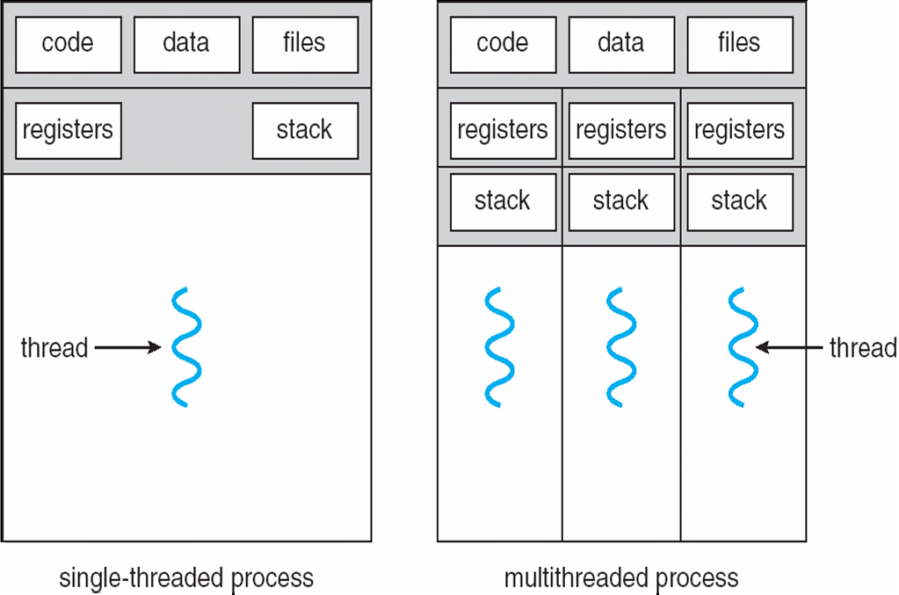
Single and Multithreaded Processes

Slide 12
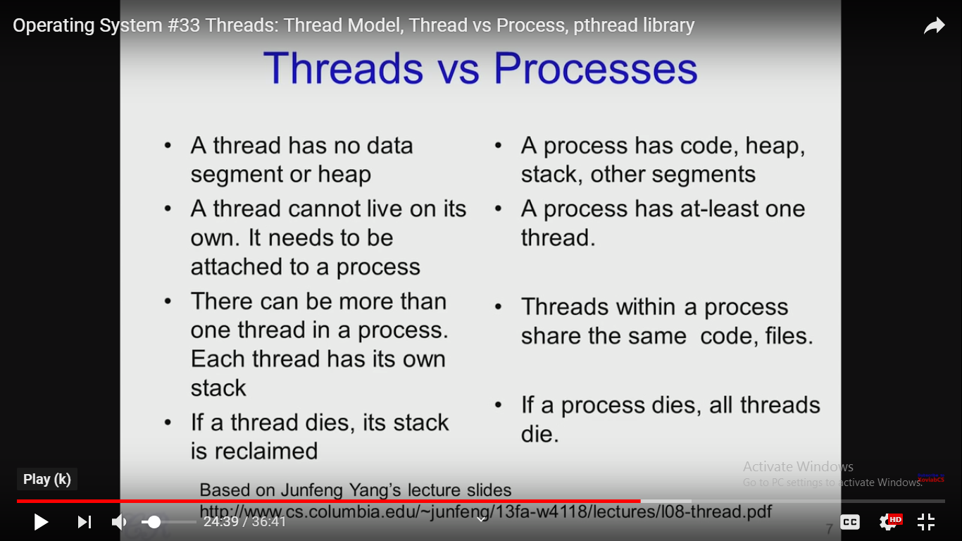

Slide 13
Who Manages Threads?
User Threads
Thread management done by user-level threads library
User Threads are supported above the Kernel and are managed without kernel support.
Kernel knows nothing about User thread
Kernel Threads
Thread directed supported and managed by the OS
Many OS kernels are now multi-threaded; several threads operate in the kernel and each thread performs a specific task

Slide 14
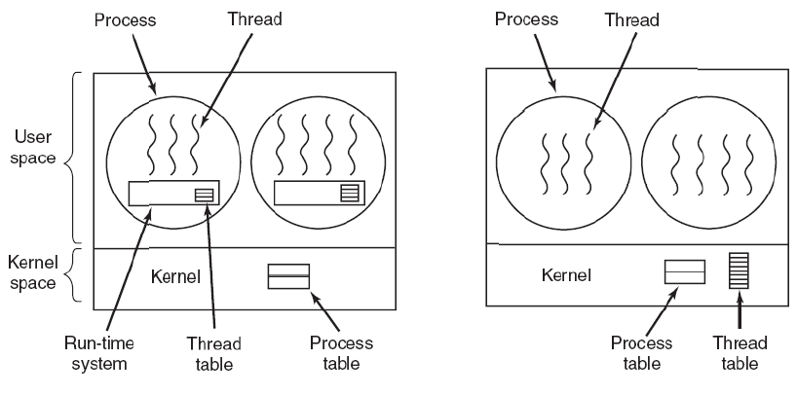
User Level Threads
No system call to manage threads. Thread library does everything.
Switching is fast, switching from user to protected mode.
Can be implemented in an OS that does not support threading.
Scheduling can be issue
Three primary thread libraries:
POSIX Pthreads
Win32 threads
Java threads

Slide 15
Kernel level Threads
Scheduler can decide to give more time to a process have large number of threads than process having less number of threads.
System call is not required
Examples
Windows XP/2000
Solaris
Linux
Tru64 UNIX
Mac OS X
There must exists a relationship between
user thread and kernel thread.

Slide 16
Multithreading Models
Many-to-One
One-to-One
Many-to-Many

Slide 17
Many-to-One
Many user-level threads mapped to single kernel thread
One thread blocking causes all to block
Multiple threads may not run in parallel on muticore system because only one may be in kernel at a time
Few systems currently use this model
Examples:
Solaris Green Threads
GNU Portable Threads

Slide 18
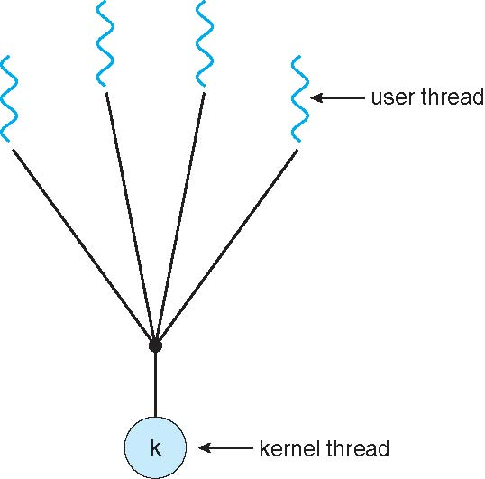
Many-to-One Model

Slide 19
One-to-One
Each user-level thread maps to kernel thread
Creating a user-level thread creates a kernel thread
More concurrency than many-to-one
Examples
Windows
Linux
Solaris 9 and later

Slide 20
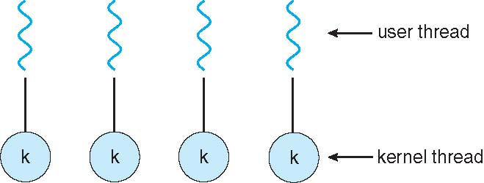
One-to-one Model

Slide 21
Many-to-Many Model
Allows many user level threads to be mapped to many kernel threads
Allows the operating system to create a sufficient number of kernel threads
Solaris prior to version 9
Windows with the ThreadFiber package

Slide 22
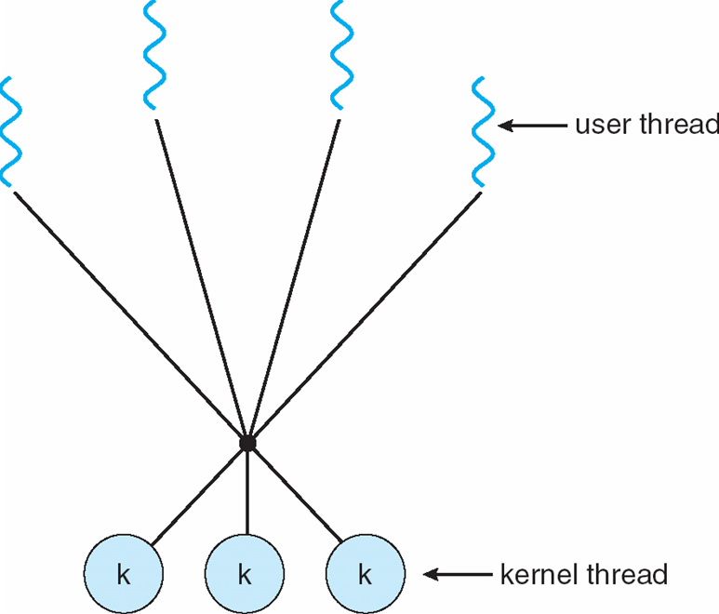
Many-to-Many Model

Slide 23
Two-level Model
Similar to M:M, except that it allows a user thread to be bound to kernel thread
Examples
IRIX
HP-UX
Tru64 UNIX
Solaris 8 and earlier

Slide 24
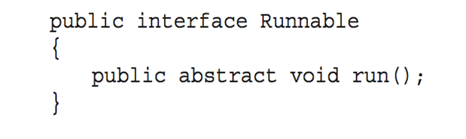
Thread Libraries
Thread library provides programmer with API for creating and managing threads
Two primary ways of implementing
Library entirely in user space
Kernel-level library supported by the OS
Pthreads
May be provided either as user-level or kernel-level
API specifies behavior of the thread library, implementation is up to development of the library
Common in UNIX operating systems (Solaris, Linux, Mac OS X)
Java Threads
Java threads are managed by the JVM
Typically implemented using the threads model provided by underlying OS
Java threads may be created by:
Extending Thread class
Implementing the Runnable interface

Slide 25
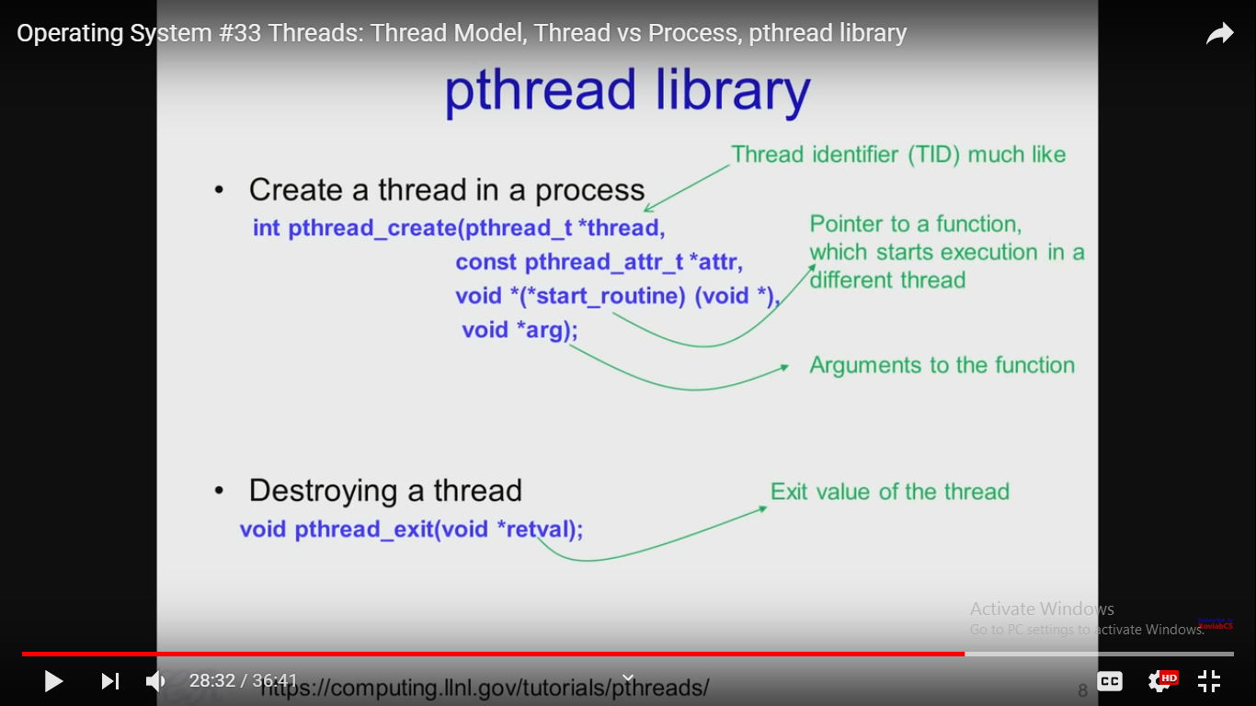
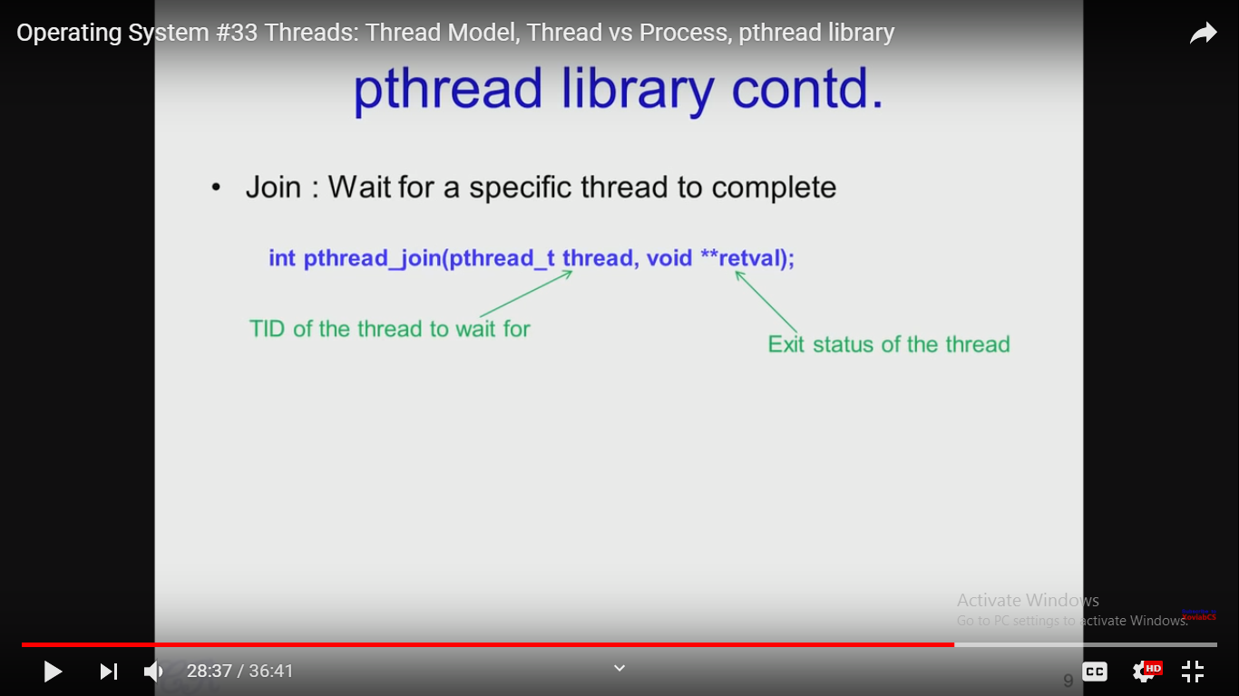

Slide 26
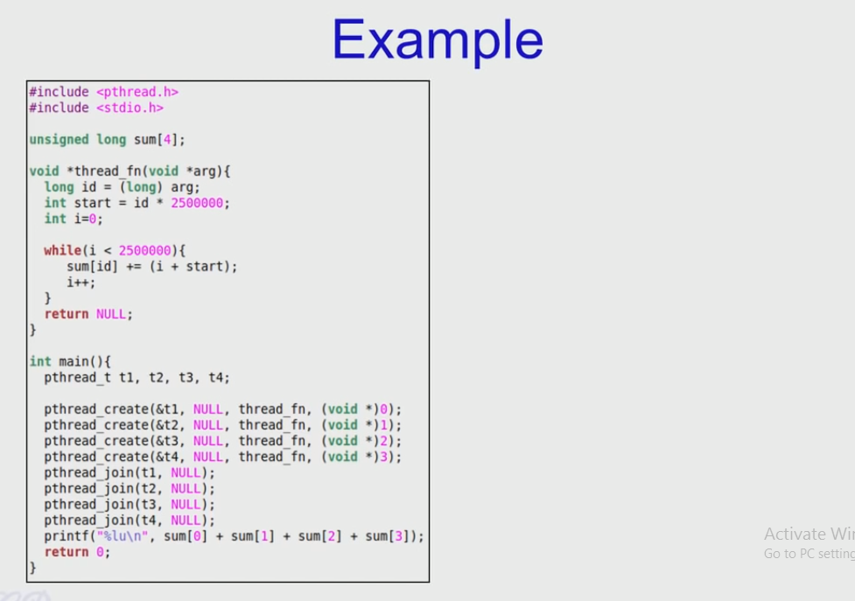

Slide 27
Threading Issues
Thread Cancellation
Signal handling
Thread pools
Thread-specific data

Slide 28
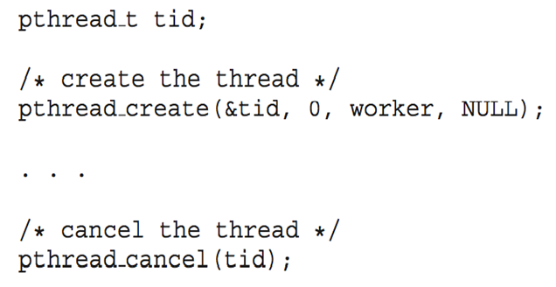
Thread Cancellation
Thread cancellation of target thread Terminating a thread before it has finished
Thread to be canceled is target thread
Two general approaches:
Asynchronous cancellation terminates the target thread immediately
Deferred cancellation allows the target thread to periodically check if it should be cancelled
Pthread code to create and cancel a thread:

Slide 29
Signal handling
Signals are used in UNIX systems to notify a process that a particular event has occurred.
Synchronous and asynchronous received signal.
A signal handler is used to process signals
Signal is generated by particular event
Signal is delivered to a process
Signal is handled by one of two signal handlers
Every Signal may be handled by one of two possible handlers:
A default signal handler
A user-defined signal handler

Slide 30
Thread Pools
Thread pools (page 141):
Create a number of threads in a pool where they await for work
Advantages:
Usually slightly faster to service a request with an existing thread than create a new thread
Allows the number of threads in the application(s) to be bound to the size of the pool
Windows API supports thread pools

Slide 31
Thread Specific Data
Thread-specific data
Create Facility needed for data private to thread/ Thread-local storage (TLS) allows each thread to have its own copy of data
Useful when you do not have control over the thread creation process (i.e., when using a thread pool)

Slide 32
End of Chapter 4 NAT

